Slide 1
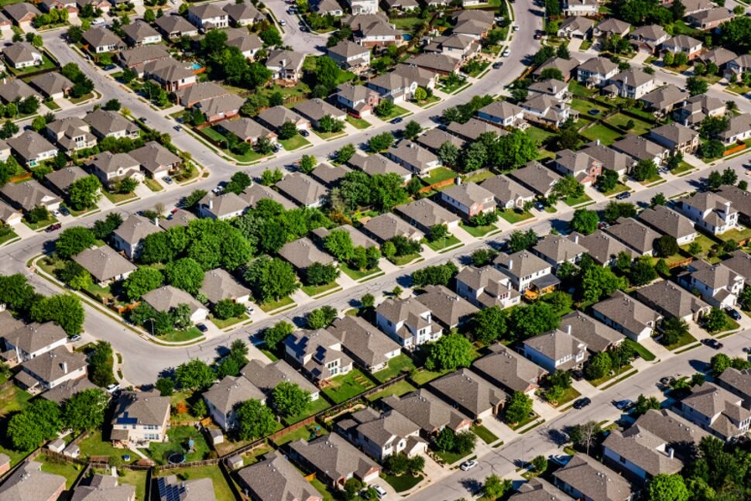
King County House price Analysis
Olaide Kashimawo
Notes:
NOTE:
To change the image on this slide, select the picture and delete it. Then click the Pictures icon in the placeholder to insert your own image.

Slide 2
Overview and Business Understanding
The King County House Dataset contains a wealth of information about the price, size, location, condition, and other features of houses in King County, Washington.
In this article, I'll show you how I used Python to create a multiple linear regression model to predict house prices.

Slide 3
Hypothesis
Does the grade have any impact on house prices?
Does the number of bedrooms have any impact on house prices?
Are waterfront houses priced higher?
Does the renovation have any impact on house prices?

Slide 4
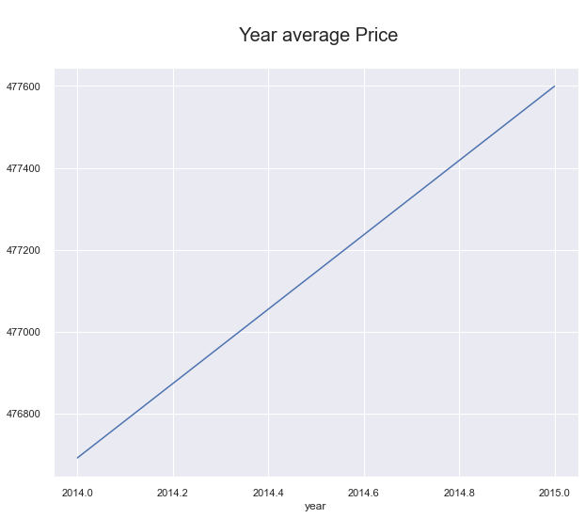
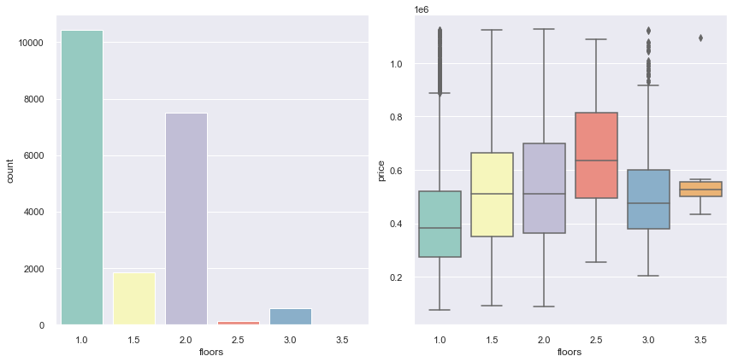
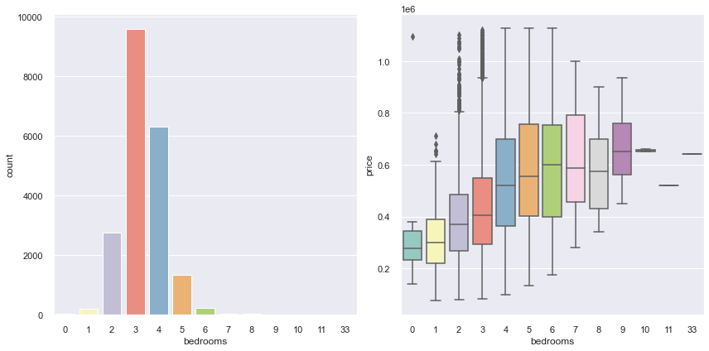
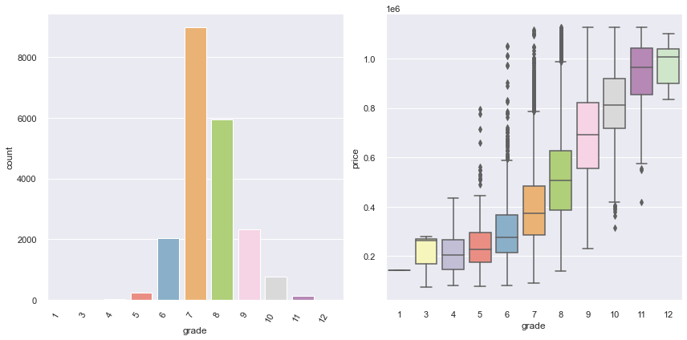
Data Analysis
Average price home: 477,6000
Average floors numbers: 1 to 2
Average Bedroom numbers : 3 to 7
Average Grade: 7 to 8

Slide 5
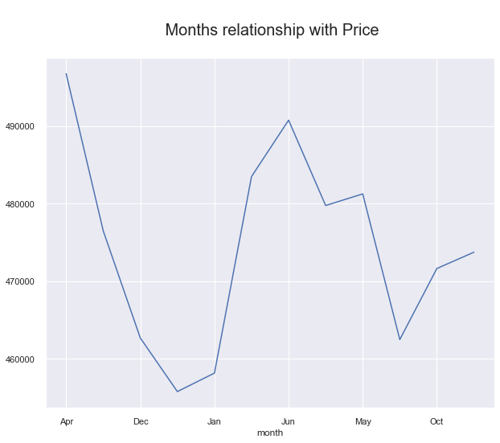
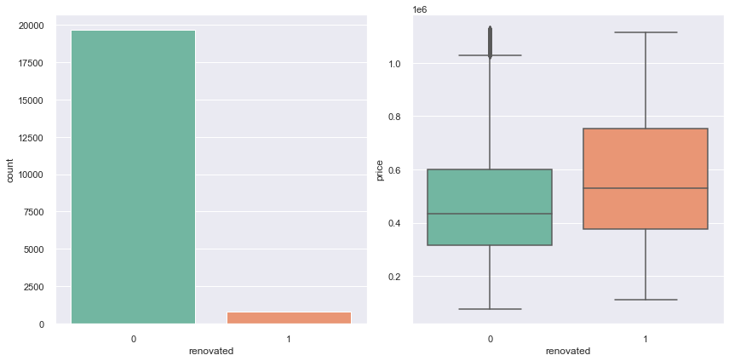
Prices rose significantly in April, May, and June, while the winter months saw lower prices.
19,701 unrenovated houses against 766 refurbished buildings. The plot below indicates that renovated properties are pricey.

Slide 6
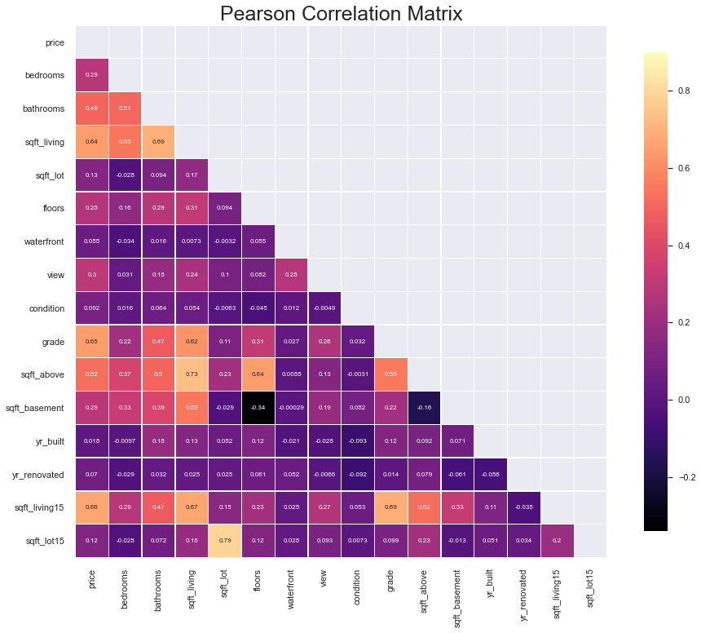
The most significant influence on house prices
Square feet living
Waterfront
Grade
Square feet above

Slide 7
Conclusion
Since the model can only explain 0.699-0.656% of the variance in house prices (R-squared), there is still some room for error.
The projections will need to be double-checked to verify they make sense given what is known about the house.
The resulting model is multicollinear, but the metrics show that it is not overfitting and can estimate house prices on unseen test data with accuracy.

Slide 8
Next Step
Future work would need more insight into how zip code influenced house prices, as the number of houses in specific zip codes have higher sales prices.
To determine the validity of the data further, I will use the polynomial regression model.

Slide 9
Thank you
GitHub: github.com/olaidekashimawo/
LinkedIn: linkedin.com/in/olaide-Kashimawo
Email:goldprint3@outlook.com

